Slide 1


Engr. Jay O. Jorolan, ECT

Slide 2
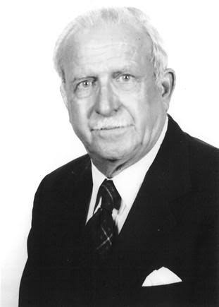
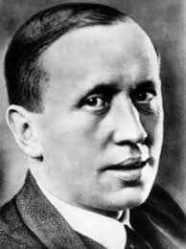
Introduction to Robotics
Robot
1920: The word "robot" was coined by Czech novelist Karel Čapek in his play titled R.U.R. (Rossum’s Universal Robots). The word comes from the Czech term for a worker or servant.
1954: The first programmable industrial robot was designed by George Devol, who coined the term "Universal Automation"

Slide 3
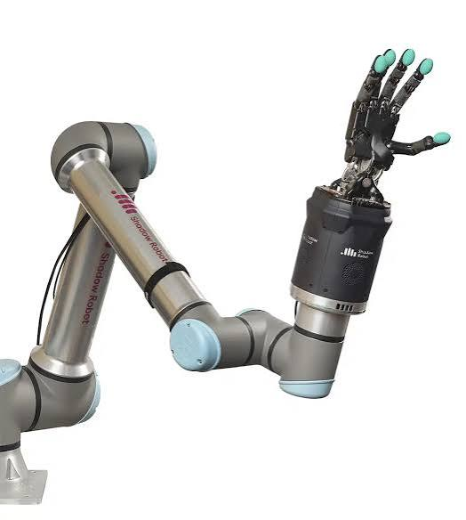
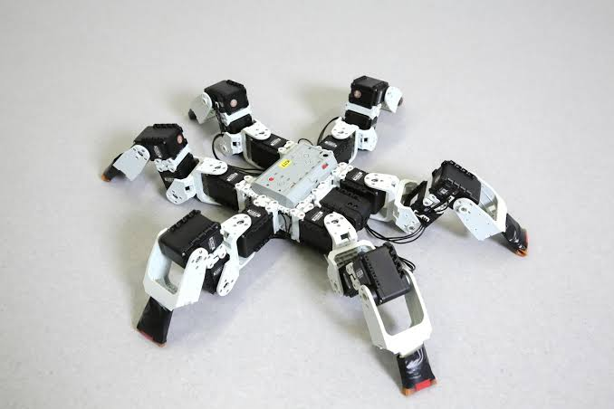
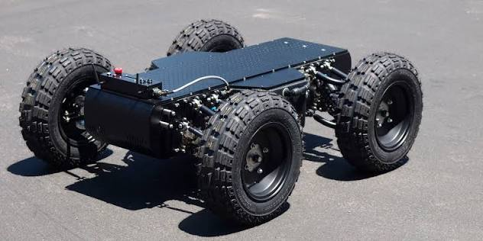
Types of Robots
Manipulator Robot
Legged Robot
Wheeled Robot
What are the purpose of Robots?

Slide 4
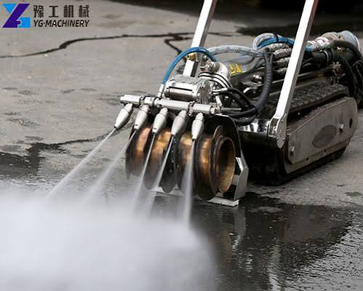
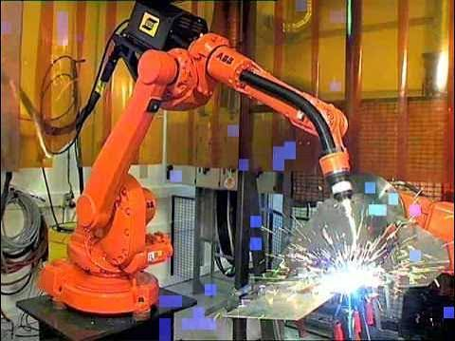
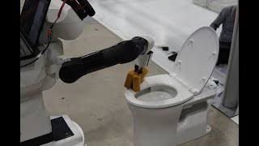
What are the purpose of Robots?
Jobs that are dangerous for humans
Welding Robot
Menial tasks that human doesn’t want to do
Decontaminating Robot
Scrubmate Robot

Slide 5
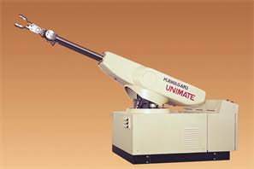
The world's first industrial robot
UNIMATE
It lifted hot pieces of die-cast metal and welded them onto car bodies (a job too dangerous for humans).
It was designed in 1954 by George Devol and installed in 1961.
It worked at a General Motors assembly line.

Slide 6
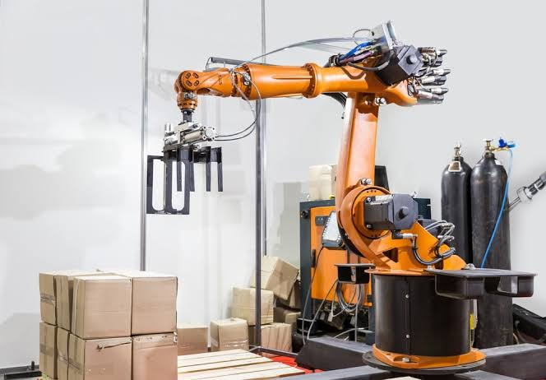
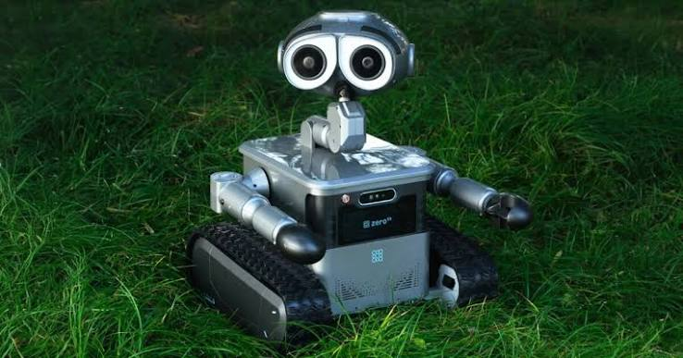
Classification of Robots
Robotic Manipulators
Mobile Robots
A robotic arm. It is designed to move, grip, and handle objects in one fixed spot.
A robot on wheels, tracks, or legs. It is designed to travel and move around from one location to another.

Slide 7
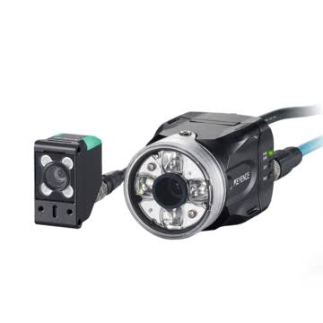
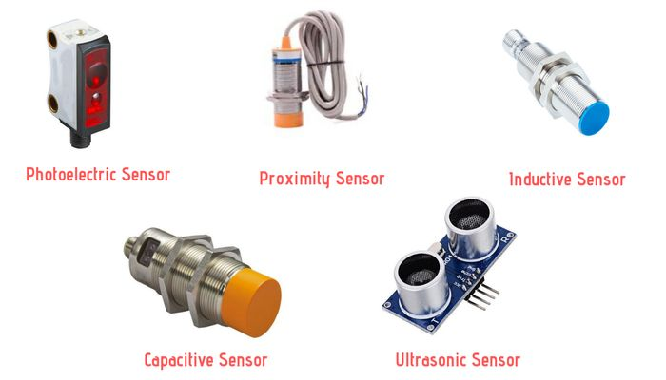
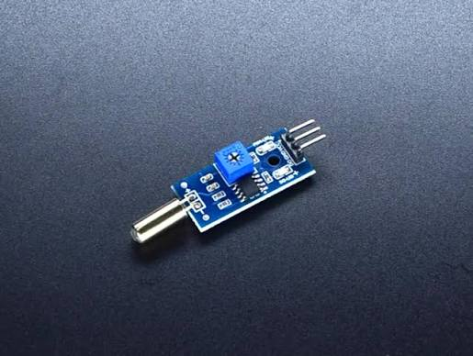
How Robots Works?
Sensors
Vision Sensors
Proximity Sensors
Tilt Sensors

Slide 8
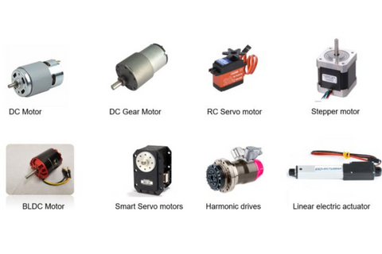
How Robots Works?
Sensors
Actuators

Slide 9
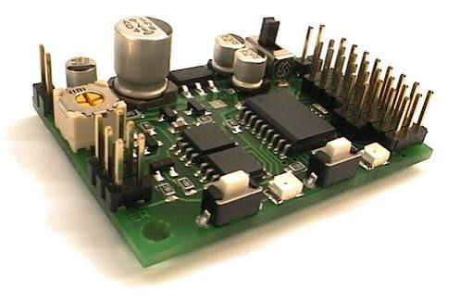
How Robots Works?
Controllers

Slide 10
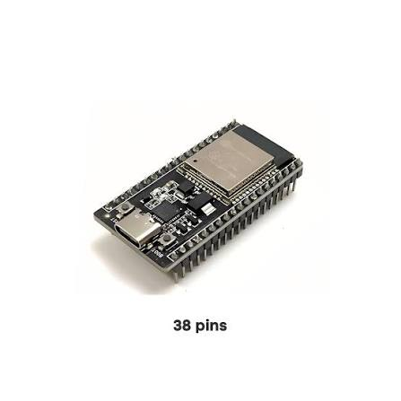
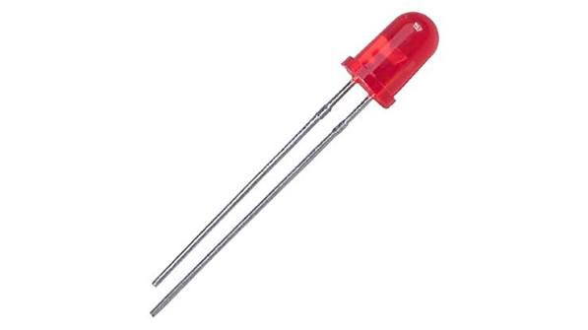
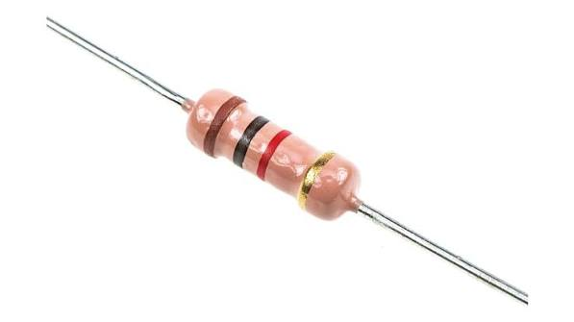
What Components/app needed in this subject?
Esp 32 With WiFi Module
Led
Resistors
E.g. 470 ohms & 1K ohms

Slide 11
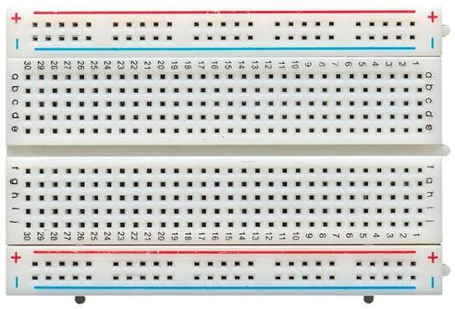
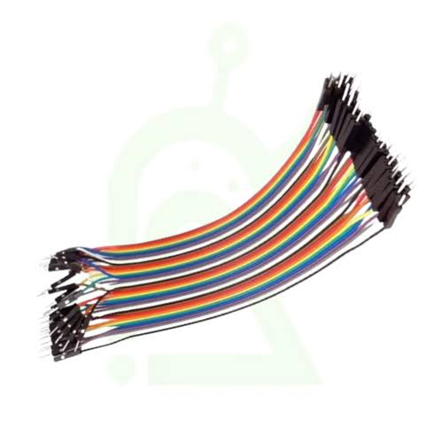
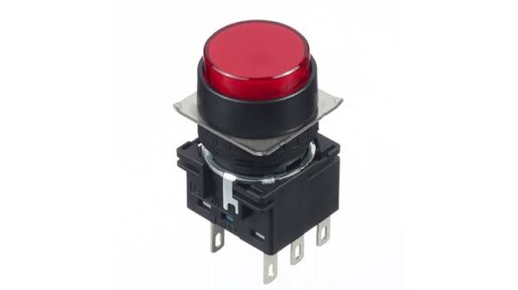
What Components/app needed in this subject?
Push button Switch
Breadboard
Connecting Wires

Slide 12

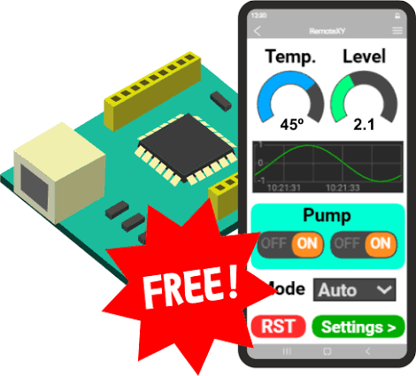
What Components/app needed in this subject?
Remote XY

